Slide 1
So You Think You Want A Private Plan
A Guide for Employers

Slide 2
General Requirements for ALL Employers
Register
Deduct
Remit
Report

Slide 3
Private Plan Substitutions
What they are
What does NOT qualify
What might qualify
Fully insured
Self-insured
When can I apply
Beginning April 1, 2025
A private plan is an employer plan that provides benefits and terms that are substantially equivalent to the State PFML Plan
Plans that only cover an individual’s own serious health condition like short term or long term disability policies
Plans that can be changed at the employer’s discretion
Plans that consist solely of leave benefits that need to accrue like sick, vacation, or paid time off

Slide 4
Fully Insured Plans
Insurer Requirements
Must be licensed in Maine
Must have a policy approved by the Bureau of Insurance
Approved policy must be certified as an eligible substantially equivalent plan by the Department
Before You Apply
Make sure you purchase a certified eligible substantially equivalent insurance plan
Employer Application Process
Apply through the portal
Select the correct insurer and plan in the dropdown
Upload the first one or two pages of the policy that show evidence of coverage
Pay the application fee
Evidence of coverage will be required as part of the application process so have that nearby

Slide 5
If you have not already done it, REGISTER in the portal
If you already registered, LOG IN to your account

Slide 6
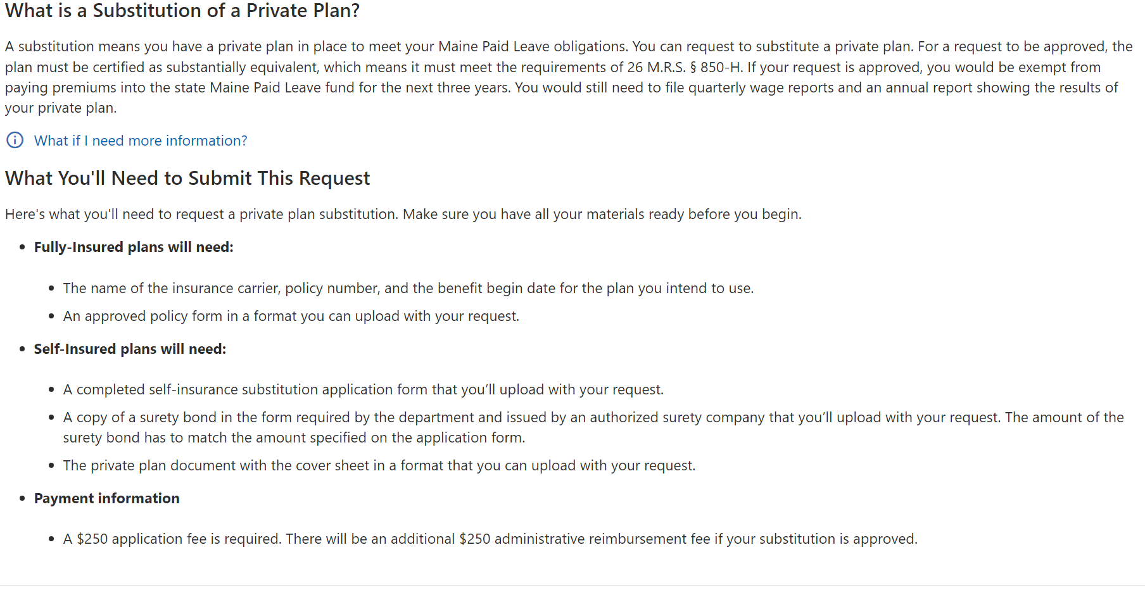

Slide 7
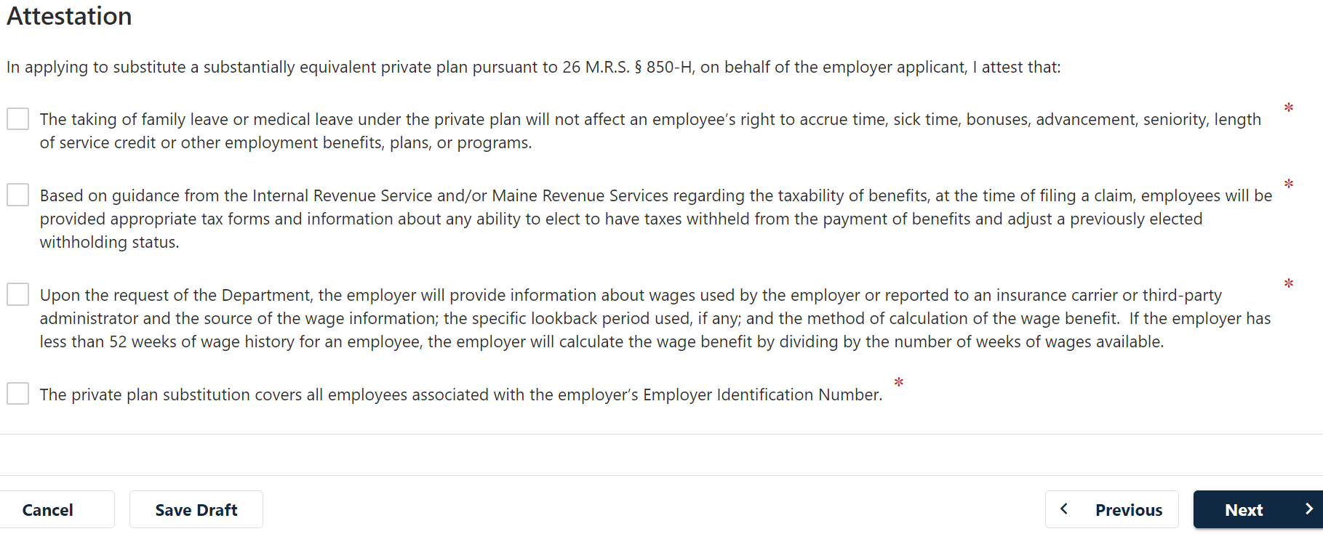

Slide 9
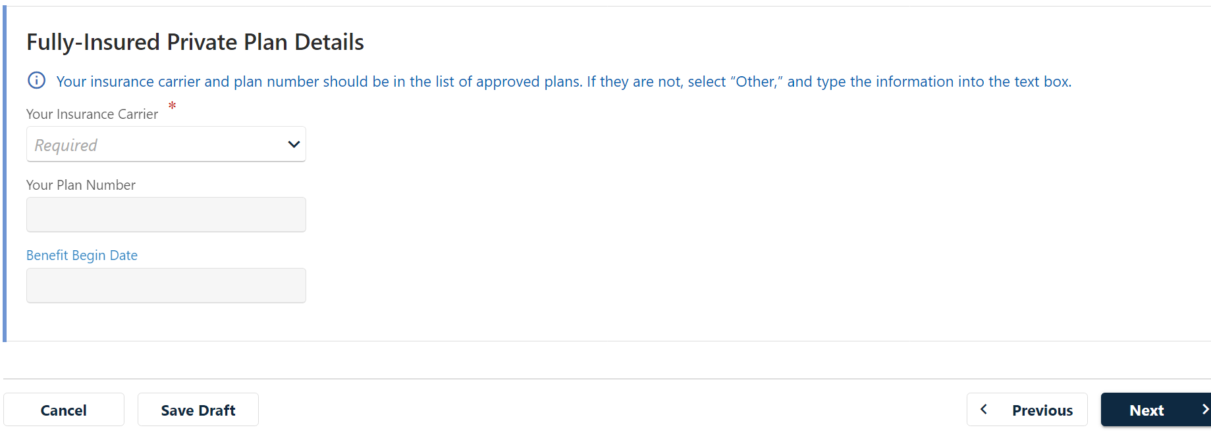

Slide 10
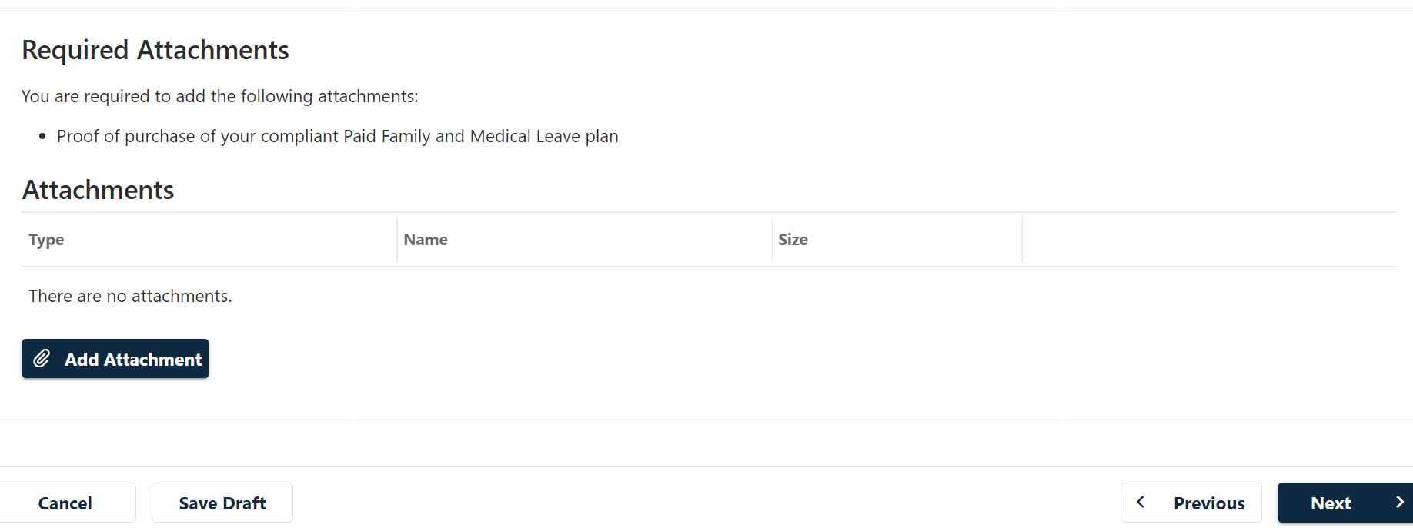

Slide 11
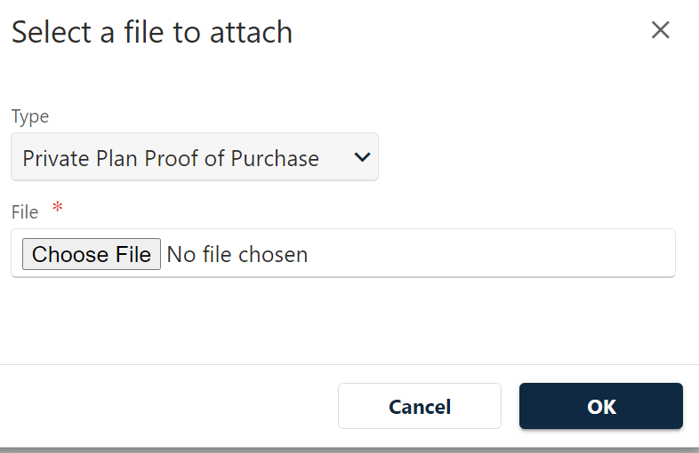

Slide 12
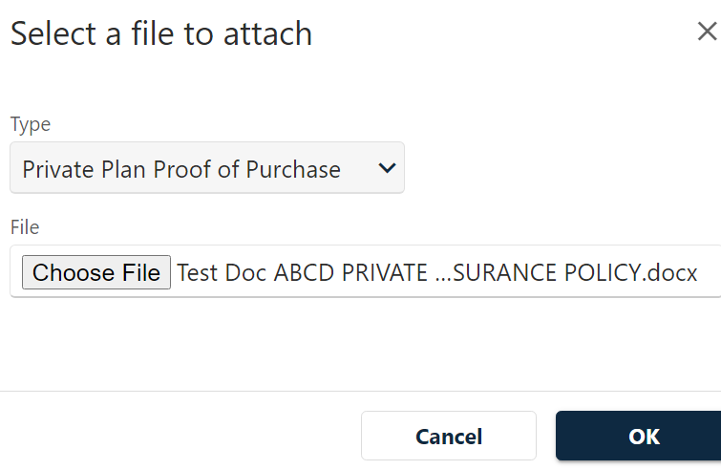

Slide 14
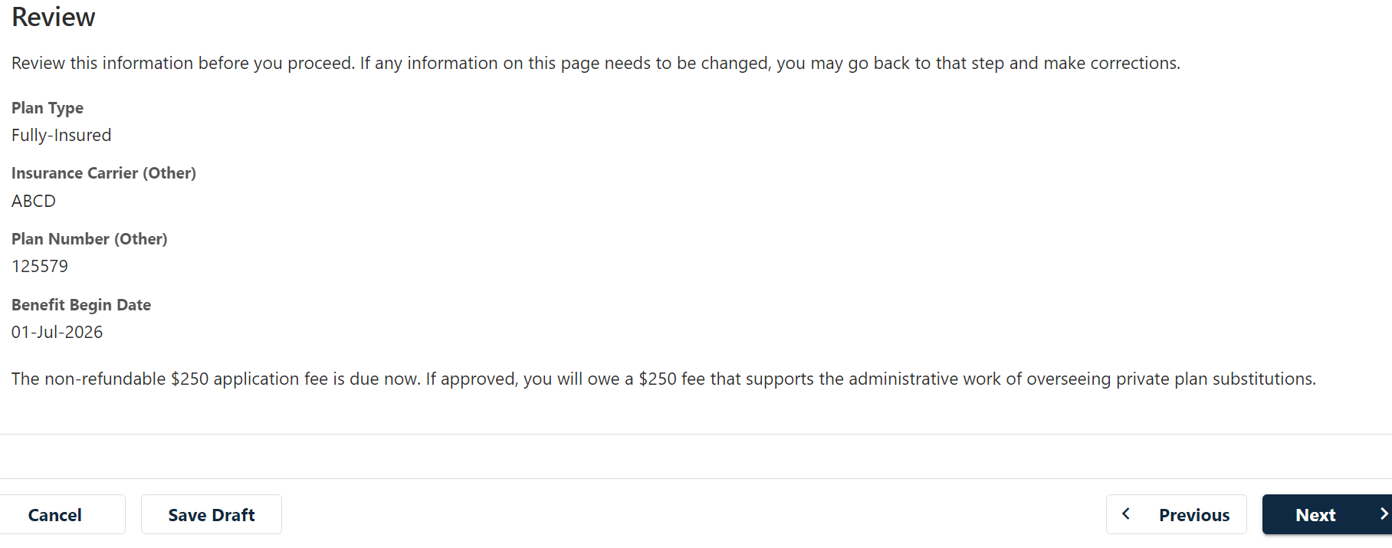

Slide 17
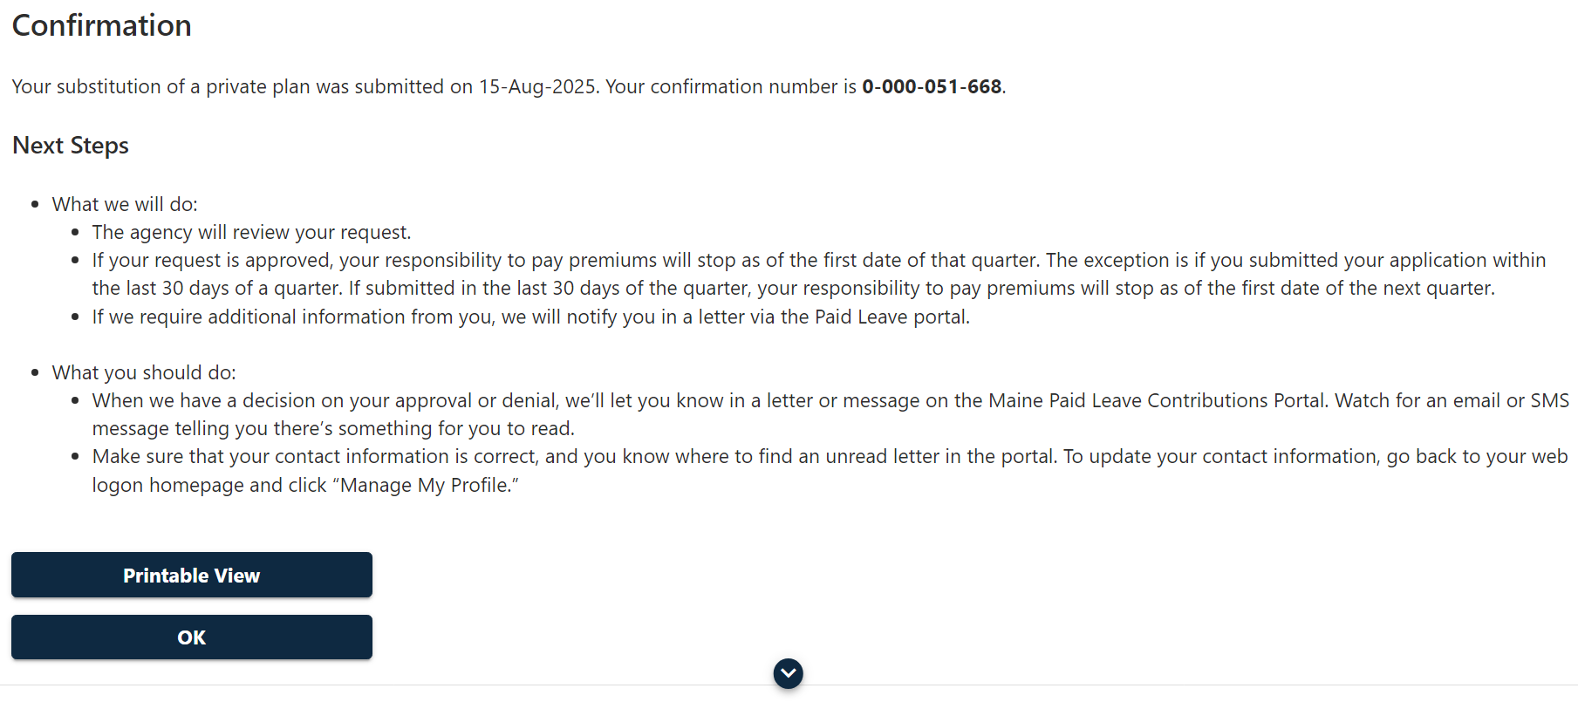

Slide 18
Fully Insured Plans
What if my plan is approved?
Notification of approval
Includes date that exemption from premium obligation begins
Will notify you that the annual administrative fee is now due
Time period
Includes effective date and end date of approval – 3 years from effective date
Ongoing obligations
REMEMBER: This only exempts you from paying contributions to the State PFML Fund
You still have an obligation to:
DON’T FORGET – if the insurance policy is cancelled for nonpayment of your premiums, your approved private plan may be revoked!
Submit quarterly wage reports
Submit an annual data report
Comply with all terms and conditions of the approved plan, laws, rules and policies

Slide 19
Fully Insured Plans
What if my plan is denied?
Notification of Denial
Basis of denial
Appeal Rights
Obligations
Your current obligations to the State don’t change:
Continue to deduct, remit, and report

Slide 20
Self-Insured Plans
Before you apply
Ask yourself:
Does my business have the financial capacity to pay PFML claims made by my employees?
Does my business have the financial, human resources, and administrative infrastructure to oversee the full administration of a private PFML plan?
If the infrastructure doesn’t exist, does my business have the financial capacity to contract with a third-party administrator?
Is there any reason why my business would have difficulty obtaining the required surety bond?

Slide 21
Self-Insured Plans
Employer Application Process
Apply through the portal
Upload your plan documents
REMEMBER: Your plan MUST be substantially equivalent to the State PFML Plan
Stay true to the law and rule
Significant deviation may result in your application for certification as an eligible plan being DENIED
Obtain and upload the surety bond
Use the surety bond form required by DOL – make sure it is signed by the surety company and not your insurance producer or broker
Bond amount = The applicable percentage from 26 MRS §850-F(3) times total wages for the most recent four quarters
Pay the application fee

Slide 22
If you have not already done it, REGISTER in the portal
If you already registered, LOG IN to your account

Slide 29
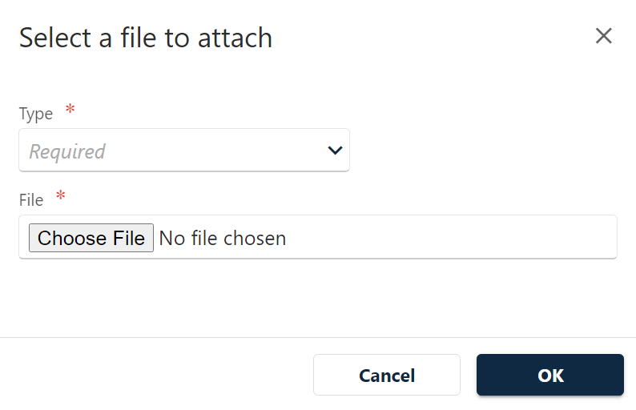

Slide 30
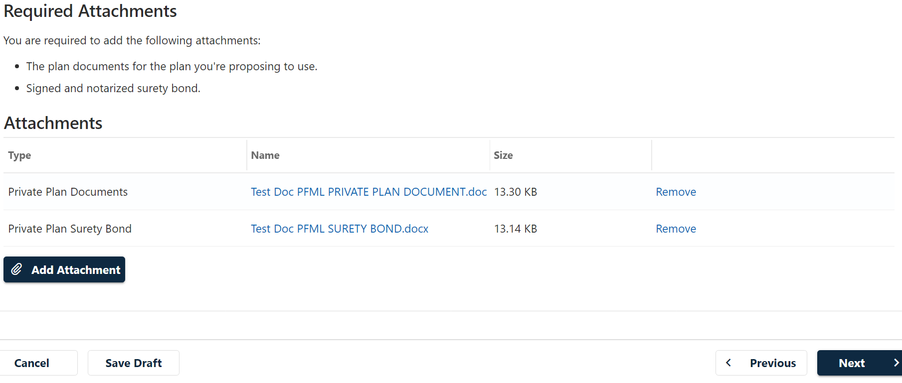

Slide 31
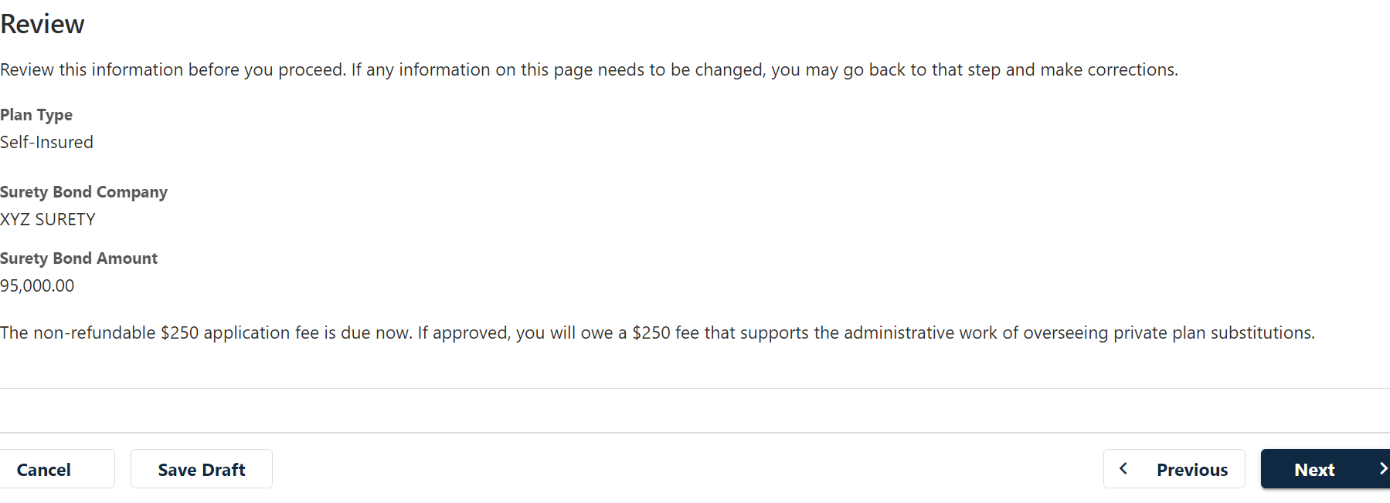

Slide 35
Self-Insured Plans
What if my plan is approved?
Notification of approval
Time period
Ongoing obligations
You still have an obligation to:
Submit quarterly wage reports
DON’T FORGET – to be approved, your plan must be certified as eligible AND your application to substitute the private plan must be approved
Includes date that exemption from premium obligation begins
Submit an annual data report
REMEMBER: This only exempts you from paying contributions to the State PFML Fund
Comply with all terms and conditions of the approved plan, laws, rules and policies
Certifies the private plan as being eligible for use as a substantially equivalent plan
Will notify you that the annual administrative fee is now due
Includes effective date and end date of approval – 3 years from effective date

Slide 36
Self-Insured Plans
What if my plan is denied certification of eligibility as a substantially equivalent plan?
Notification of Denial
Basis of denial
Appeal Rights
What if my application to substitute a private plan is denied?
Notification of Denial
Basis of denial
Appeal Rights
REMEMBER: Your current obligations to the State will remain the same even during any appeal: deduct, remit, and report

Slide 37
Some Final Thoughts
Make sure to sign up for notifications from the Maine PFML program
Check your employer account through the portal regularly
Approval from the Department is required BEFORE:
Any material changes to your plan
If you think you may have good cause to cancel your approved plan
Approval of your plan can be revoked by the Department under certain circumstances

Slide 38
GET ANSWERS TO YOUR QUESTIONS
DON’T STRESS! WE’RE HERE TO HELP
CHECK THE WEBSITE: maine.gov/paidleave
SEND A MESSAGE THROUGH YOUR PORTAL ACCOUNT
CALL US AT 207-621-5024

